Slide 1
COMPUTER ORGANIZATION
B.TECH III SEM
CSE-4
N SANTOSHI
ASSISTANT PROFESSOR
DEPARTMENT OF ECE

Slide 2
NUMBER SYSTEMS
DECIMAL NUMBER SYSTEM
0,1,2,3,4,5,6,7,8,9
BINARY NUMBER SYSTEM
0,1
OCTAL NUMBER SYSTEM
0,1,2,3,4,5,6,7
HEXADECIMAL NUMBER SYSTEM
0,1,2,3,4,5,6,7,8,9,A,B,C,D,E,F

Slide 3
Complements
There are two types of complements for each base r system: the r's complement and the (r - l)'s complement.
When the value of the base r is substituted in the name, the two types are referred to as the 2's and I's complement for binary numbers and the 10's and 9's complement for decimal numbers.

Slide 4
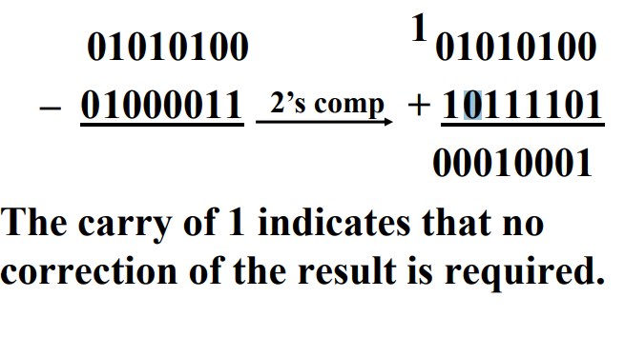
Subtraction of Unsigned Numbers
Unsigned 2’s Complement Subtraction Example
Find 01010100₂ – 01000011₂

Slide 5
Fixed-Point Representation
Positive integers, including zero, can be represented as unsigned numbers.
To represent negative integers, we need a notation for negative values.
In ordinary arithmetic, a negative number is indicated by a minus sign and a positive number by a plus sign.
Because of hardware limitations, computers must represent everything with 1's and 0's, including the sign of a number.
sign bit equal to 0 for positive and to 1 for negative.

Slide 6
In addition to the sign, a number may have a binary (or decimal) point.
The position of the binary point is needed to represent fractions, integers, or mixed integer-fraction numbers.
There are two ways of specifying the position of the binary point in a register:
by giving it a fixed position or
by employing a floating-point representation.

Slide 7
The two positions most widely used are
binary point in the extreme left of the register to make the stored number a fraction
binary point in the extreme right of the register to make the stored number an integer.

Slide 8
Integer Representation
When an integer binary number is positive, the sign is represented by 0 and the magnitude by a positive binary number. When the number is negative, the sign is represented by 1 but the rest of the number may be represented in one of three possible ways:
Signed-magnitude representation
Signed-1' s complement representation
Signed 2' s complement representation

Slide 9
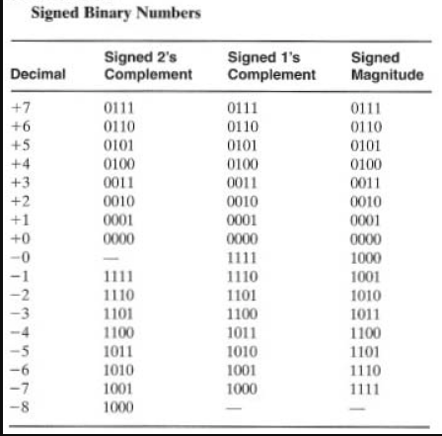
Signed numbers

Slide 10
The signed-magnitude representation of a negative number consists of the magnitude and a negative sign.
The negative number is represented in either the 1's or 2's complement of its positive value.
For example, consider the signed number 14 stored in an 8-bit register.
+ 14 is represented by a sign bit of 0 in the leftmost position followed by the binary equivalent of 14: 00001110.

Slide 11
Although there is only one way to represent + 14, there are three different ways to represent - 14 with eight bits.
In signed-magnitude representation 1 0001110
In signed-1's complement representation 1 1110001
In signed-2's complement representation 1 11 10010

Slide 12
The 1' s complement imposes difficulties because it has two representations of 0 ( + 0 and - 0).

Slide 13
Arithmetic Addition
The addition of two numbers in the signed-magnitude system follows the rules of ordinary arithmetic. If the signs are the same, we add the two magnitudes and give the sum the common sign.
If the signs are different, we subtract the smaller magnitude from the larger and give the result the sign of the larger magnitude.
For example,( + 25) + (- 37) = - (37 - 25) = - 12 and is done by subtracting the smaller magnitude 25 from the larger magnitude 37 and using the sign of 37 for the sign of the result.
This is a process that requires the comparison of the signs and the magnitudes and then performing either addition or subtraction.

Slide 14
2's complement addition
the rule for adding numbers in the signed-2's complement system does not require a comparison or subtraction, only addition and complementation.
The procedure is very simple and can be stated as follows: Add the two numbers, including their sign bits, and discard any carry out of the sign (leftmost) bit position.
Note that negative numbers must initially be in 2' s complement and that if the sum obtained after the addition is negative, it is in 2's complement form.

Slide 15
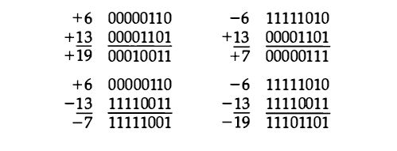
Example
In each of the four cases, the operation performed is always addition, including the sign bits. Any carry out of the sign bit position is discarded, and negative results are automatically in 2' s complement form.

Slide 16
To determine the value of a negative number when in signed-2's complement, it is necessary to convert it to a positive number to place it in a more familiar form.
For example, the signed binary number 1111 1001 is negative because the leftmost bit is I. Its 2' s complement is 00000111, which is the binary equivalent of +7. We therefore recognize the original negative number to be equal to - 7 .

Slide 17
Arithmetic Subtraction
Take the 2‘s complement of the subtrahend (including the sign bit) and add it to the minuend (including the sign bit). A carry out of the sign bit position is discarded.

Slide 18
Overflow
When two numbers of n digits each are added and the sum occupies n+1 digits, we say that an overflow occurred.
An overflow is a problem in digital computers because the width of registers is finite.
A result that contains n+1 bits cannot be accommodated in a register with a standard length of n bits.
For this reason, many computers detect the occurrence of an overflow, and when it occurs, a corresponding flip-flop is set which can then be checked by the user.

Slide 19
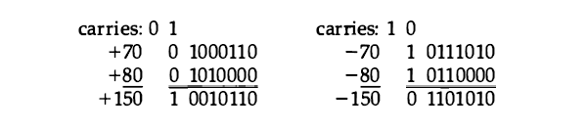
example
Note that the 8-bit result that should have been positive has a negative sign bit and the 8-bit result that should have been negative has a positive sign bit. If, however, the carry out of the sign bit position is taken as the sign bit of the result, the 9-bit answer so obtained will be correct. Since the answer cannot be accommodated within 8 bits, we say that an overflow occurred.

Slide 20

Decimal Fixed-Point Representation
The representation of decimal numbers in registers is a function of the binary code used to represent a decimal digit.
A 4-bit decimal code requires four flip-flops for each decimal digit.
The representation of 4385 in BCD requires I6 flip-flops, four flip-flops for each digit. The number will be represented in a register with I6 flip-flops as follows:

Slide 21
By representing numbers in decimal we are wasting a considerable amount of storage space since the number of bits needed to store a decimal number in a binary code is greater than the number of bits needed for its equivalent binary representation.
However, there are some advantages in the use of decimal representation because computer input and output data are generated by people who use the decimal system.
However, there are some advantages in the use of decimal representation because computer input and output data are generated by people who use the decimal system.

Slide 22
For this reason, some computers and all electronic calculators perform arithmetic operations directly with the decimal data (in a binary code) and thus eliminate the need for conversion to binary and back to decimal.
The sign of a decimal number is usually represented with four bits to conform with the 4-bit code of the decimal digits. It is customary to designate a plus with four 0' s and a minus with the BCD equivalent of 9, which is 1001 .

Slide 23

Consider the addition (+375) + (-240) = + 135 done in the signed- 10’s complement system.

Slide 24
The 9 in the leftmost position of the second number indicates that the number is negative. 9760 is the 10's complement of 0240.
The two numbers are added and the end carry is discarded to obtain +135.

Slide 25

Floating-Point Representation
The floating-point representation of a number has two parts.
The first part represents a signed, fixed-point number called the mantissa. The second part designates the position of the decimal (or binary) point and is called the exponent.
The fixed-point mantissa may be a fraction or an integer.
For example, the decimal number +6132.789 is represented in floating-point with a fraction and an exponent as follows:
Example

Slide 26

This representation is equivalent to the scientific notation +0. 6132789 X 10^{+4.}
Floating-point is always interpreted to represent a number in the following form:
Only the mantissa m and the exponent e are physically represented in the register (including their signs).

Slide 27

A floating-point binary number is represented in a similar manner except that it uses base 2 for the exponent. For example, the binary number +1001. 11 is represented with a n 8-bit fraction and 6-bit exponent a s follows:

Slide 28
The fraction has a 0 in the leftmost position to denote positive. The binary point of the fraction follows the sign bit but is not shown in the register. The exponent has the equivalent binary number +4. The floating-point number is equivalent to

Slide 29
Normalisation
Normalisation is the process of moving the binary point so that the first digit after the point is a significant digit.
A floating-point number is said to be normalized if the most significant digit of the mantissa is nonzero.
For example, the decimal number 350 is normalized but 00035 is not.

Slide 30
For example, the 8-bit binary number 00011010 is not normalized because of the three leading 0' s. The number can be normalized by shifting it three positions to the left and discarding the leading O's to obtain 11010000.
The three shifts multiply the number by 2³ = 8. To keep the same value for the floating-point number, the exponent must be subtracted by 3 .

Slide 31
Alphanumeric representation
Many applications of digital computers require the handling of data that consist not only of numbers, but also of the letters of the alphabet and certain special characters.
An alphanumeric character set is a set of elements that includes the 10 decimal digits, the 26 letters of the alphabet and a number of special characters, such as $, + , and = .

Slide 32
The standard alphanumeric binary code is the ASCII (American Standard Code for Information Interchange), which uses seven bits to code 128 characters.
Binary codes play an important part in digital computer operations.
The codes must be in binary because registers can only hold binary information.

Slide 33
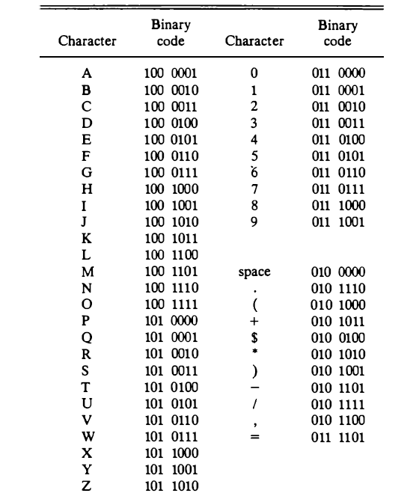
ASCII CODES

Slide 34
The ASCII code is the standard code commonly used for the transmission of binary information.
Each character is represented by a 7-bit code and usually an eighth bit is inserted for parity.
The code consists of 128 characters.

Slide 35
EBCDIC
Another alphanumeric (sometimes called alphameric) code used in IBM equipment is the EBCDIC (Extended BCD Interchange Code).
It uses eight bits for each character (and a ninth bit for parity). EBCDIC has the same character symbols as ASCII but the bit assignment to characters is different.

Slide 36
Adders
Binary addition is a fundamental operation in most digital circuits.
There are a variety of adders, each has certain performance.
Each type of adder is selected depending on where the adder is to be used.
Ripple carry adder is suitable for small bit applications.

Slide 37
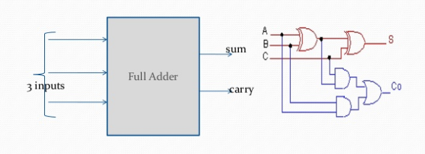
Full adder
combinational circuit that adds two bits is called a half adder.
A full adder is one that adds three bits Full Adder sum 3 inputs carry.

Slide 38
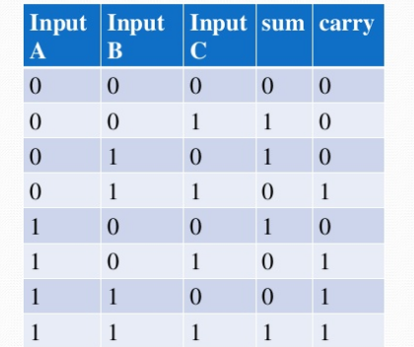
Truth table

Slide 39
N-bit binary adder/ripple carry adder
The ripple carry adder is constructed by cascading full adder blocks in series.
The carryout of one stage is fed directly to the carry-in of the next stage .
For an n-bit ripple adder, it requires n full adders/n-1 full adders and 1 half adder.

Slide 40
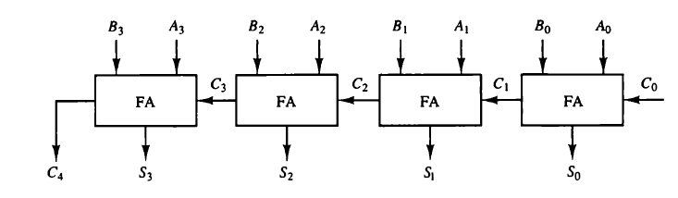
Block diagram of ripple carry adder

Slide 41
To implement the add microoperation with hardware, we need the registers that hold the data and the digital component that performs the arithmetic addition. The digital circuit that forms the arithmetic sum of two bits and a previous carry is called a full-adder.
The digital circuit that generates the arithmetic sum of two binary numbers of any length is called a binary adder.

Slide 42
The binary adder is constructed with full-adder circuits connected in cascade, with the output carry from one full-adder connected to the input carry of the next full-adder.
The augend bits of A and the addend bits of B are designated by subscript numbers from right to left, with subscript 0 denoting the low-order bit. The carries are connected in a chain through the full-adders. The input carry to the binary adder is C₀ and the output carry is C₄. The S outputs of the full-adders generate the required sum bits.

Slide 43
An n-bit binary adder requires n full-adders. The output carry from each full-adder is connected to the input carry of the next-high-order full-adder.

Slide 44
Advantages
We can add two n-bit numbers easily.
It is advantageous for less number of bit operations.

Slide 45
Disadvantages
Ripple-carry adder, illustrating the delay of the carry bit.
The disadvantage of the ripple-carry adder is that it can get very slow when one needs to add many bits.
To reduce the computation time, there are faster ways to add two binary numbers by using carry look ahead adders.

Slide 46
Carry Look Ahead Adder (CLA)
Carry look ahead adder’s (CLA) logic diagram is given below. It contains 3 blocks; “P and G generator”, “Carrylook ahead” block and “adder block
Input “Augend”, “Addend” is provided to the “P and G generator” block whose output is connected with CLA and the adder block.

Slide 47
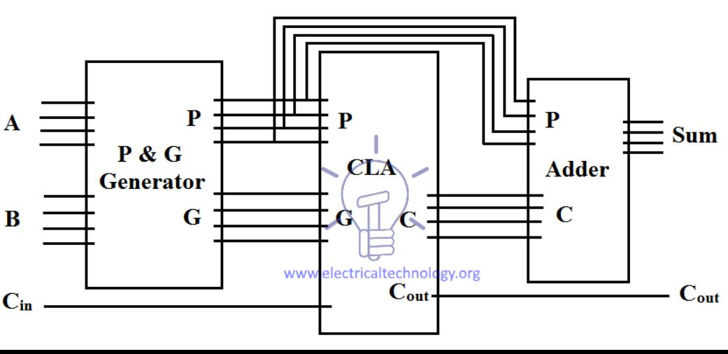
Carry = AB + C_{in} (A XOR B)
P = (A XOR B): P is known as Carry propagate, because it propagates the C_{in} from previous stage to the next stage.
G = AB: G is known as Carry Generate, because it can directly generate carry bit without any C_{in}.

Slide 48
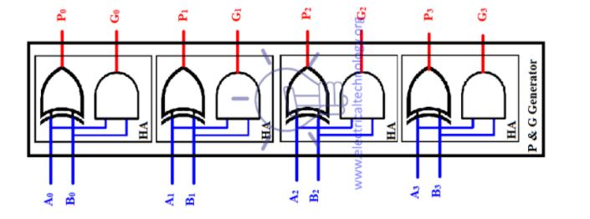
Carry Lookahead (CLA) Block Diagram

Slide 49
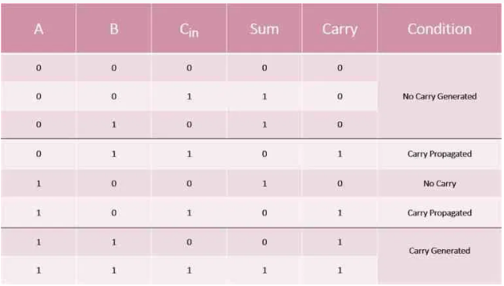
Let us consider a full adder. We have the inputs signals A, B, and Cin. If we consider the addition of these three variables in every possible case, we get a truth table like the one below.

Slide 50
On analyzing the truth table, we see that the Carry is 1 when
Either the value of A or B is one, as well as Cin, is 1, or
Both A and B have the value 1.

Slide 51


Let us now consider two new variables, Carry Generate (Gi) and Carry Propagate (Pi).
Case1: we see that an output carry is propagated, when we give an input carry. We will refer to this with Pi. So, the mathematical expression of Pi can we represented as :
case 2: we see that an output carry is generated when both inputs, A and B, are high, regardless of the value of the input carry. We will refer to this output carry as Gi. Thus, we can mathematically express Gi as :

Slide 52


Originally, for a full adder we have the following equations:
Or carry_{i+1}=AB+BC_{i}+AC_{i}
Thus, we can rewrite the equations of the full adder in terms of Carry Propagate (Pi) and Carry Generate (Gi) as :

Slide 53
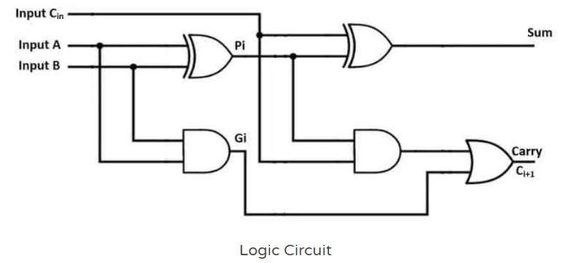
The equations of Sum and Carry can be represented by a logic circuit given below.

Slide 54
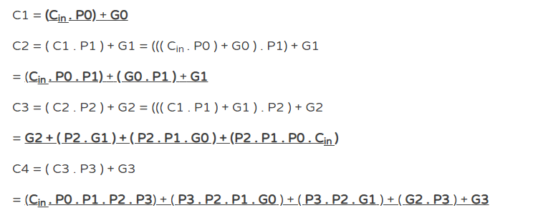
We can calculate the output carry C1, C2, C3, and C4 using the above derived equations as:

Slide 55
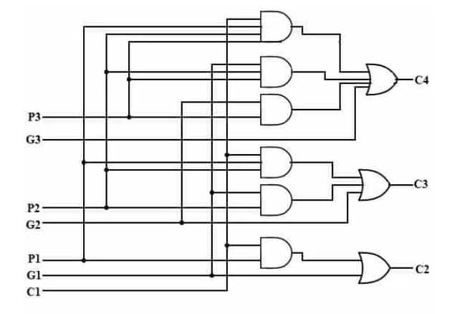
Circuit Diagram of 4-bit Carry-Lookahead Adder

Slide 56
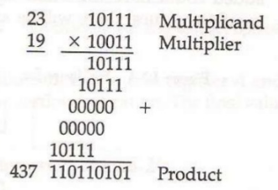
Multiplication – shift-and add
A multiplication algorithm is an algorithm (or method)to multiply two numbers. Depending on the size of the numbers,different algorithms are in use. Efficient multiplicationalgorithms have existed since the advent of the decimal system.

Slide 57
Instead of as many number of registers as there are bits in multiplier, it is convenient to provide an adder for the summation of only two successive binary numbers.
Instead of shifting the multiplicand to the left , the partial product will be shifted to the right.
when the corresponding bit of multiplier is 0, there is no need to add all zeros to the partial product.
Eg: 10011
X 11
---------------------------
111001

Slide 58
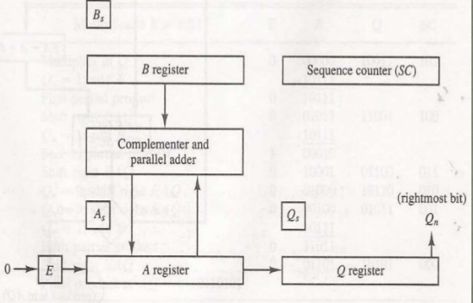
Hardware implementation

Slide 59
The multiplicand is in register B and multiplier is in Q. The SC is initially set a number equal to the number of bits in multiplier.
The counter is decremented by 1 after forming each partial product.
The sum of A and B forms a partial product which is transferred to the EA register.
Both the partial product and multiplier are shifted to the right. shrEAQ.
The LSB of A is shifted into MSB of Q, The bit from E is shifted into MSB of A, and 0 is shifted into E.
In this manner the right most bit of the multiplier will be the one which must be inspected next.

Slide 60
FLOW CHART
START
MULTIPLICAND IN B
MULTIPLIER IN Q, SC=n
A=0,E=0
=0
=1
Qn
EA=A+B
SHR EAQ
SC=SC-1
≠0
=0
SC
END
product is in AQ

Slide 61
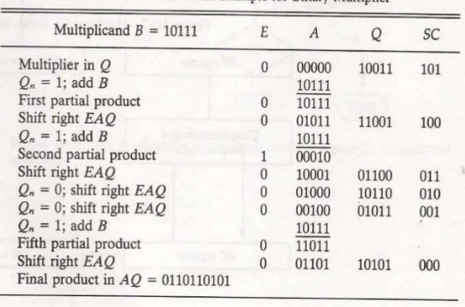
Numeric example for binary multiplier

Slide 62
Booth’s multiplier
Booth's multiplication algorithm is an algorithm which multiplies 2 signed integers in 2's complement.
The multiplicand and multiplier are placed in the m and Q registers respectively.
A 1 bit register is placed logically to the right of the LSB (least significant bit) Q0 of Q register.This is denoted by Q-1.

Slide 63
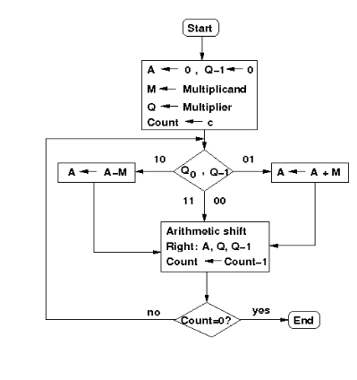
Flow chart

Slide 64
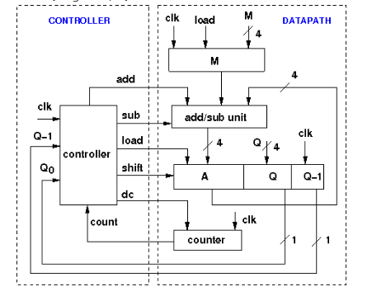
Hardware implementation

Slide 65
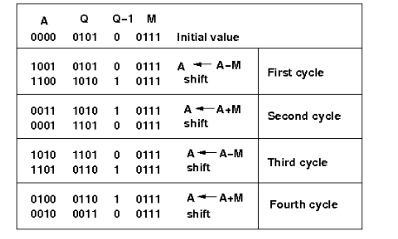
Set M as 0111 which is 7 and Q as 0101 which is 5. Now start the multiplication operation and observe the results including the intermediate results.

Slide 66
Multiplier Q=7=0111 and multiplicand M= -6 = 1010(as negetive results are automatically in 2’s complement form). [A flip-flop (a fictitious bit position)is used to the right of lsb of the multiplier and it is initialized to 0]
Product= AQ= 1101 0110, it shows that the product is negative number so to get the number in familiar form we take 2’s complement of magnitude. The result is -42 .
INTIAL VALUES | M 1010 | A 0000 | Q 0111 | Q-1 0
A=A-M SHIFT | 1010 1010 | 0110 0011 | 0111 0011 | 0 1
SHIFT | 1010 | 0001 | 1001 | 1
SHIFT | 1010 | 0000 | 1100 | 1
A=A+M SHIFT | 1010 1010 | 1010 1101 | 1100 0110 | 1 0

Slide 67
It can handle signed integers in 2's complement notion
It decreases the number of addition and subtraction
It requires less hardware than combinational multiplier
It is faster than straightforward sequential multiplier

Slide 68
Carry save multiplier
1110
1010
0000
11110
10000
1110
10001100
Multiplicand
Multiplier
Partial product
Partial product
Partial product
Partial product
Final product

Slide 69
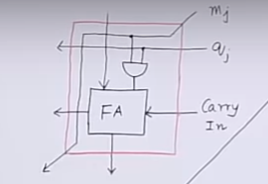

Slide 70
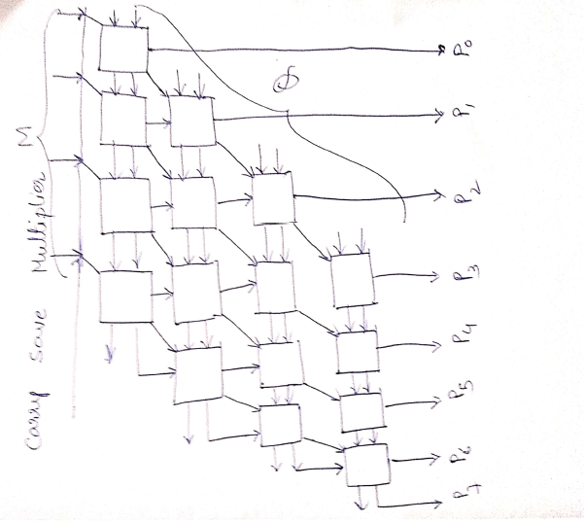

Slide 71
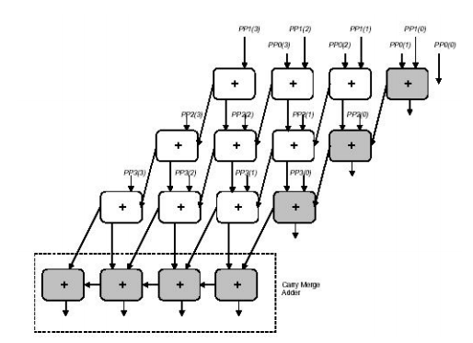

Slide 72
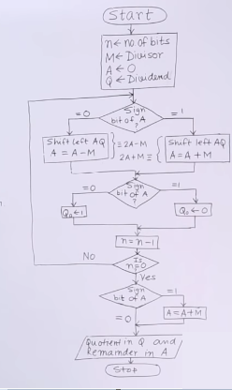
Non restoring division Algorithm

Slide 73
11(dividend)/3(divisor)=3(quotient) and 2(remainder) -M=11101
N | M | A | Q | Operation
4 | 00011 | 00000 | 1011 | intialization
 |  | 00001 | 011? | SL AQ
 |  | 11110 | 011? | A=A-M
3 |  | 11110 | 0110 | Q₀
 |  | 11100 | 110? | SL AQ
 |  | 11111 | 110? | A=A+M
2 |  | 11111 | 1100 | Q₀
 |  | 11111 | 100? | SL AQ
 |  | 00010 | 100? | A=A+M
1 |  | 00010 | 1001 | Q₀
 |  | 00101 | 001? | SL AQ
 |  | 00010 | 001? | A=A-M
0 |  | 00010 | 0011 | Q₀
0
0
1
1

Slide 74
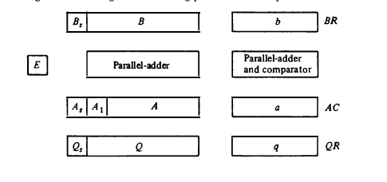
Floating-Point Arithmetic Operations

Slide 75
There are three registers, BR, AC , and QR.
Each register is subdivided into two parts.
The mantissa part has the same uppercase letter symbols as in fixed-point representation. The exponent part uses the corresponding lowercase letter symbol.
each floating-point number has a mantissa in signed magnitude representation and a biased exponent.

Slide 76
Thus the AC has a mantissa whose sign is in A, and a magnitude that is in A. The exponent is in the part of the register denoted by the lowercase letter symbol a. most significant bit of A, labeled by A1•
Similarly, register BR i s subdivided into B_{S}, B, and b, and QR into
A parallel-adder adds the two mantissas and transfers the sum into A and the carry into E. A separate parallel-adder is used for the exponents. Q_{S}, Q , and q.

Slide 77
Floating point Addition and Subtraction
In floating-point arithmetic:
two floating-point operands are in AC and BR .
The sum or difference is formed in the AC .
There are four basic phases of the algorithm for addition and subtraction:
Check for zeros
Align the mantissas
Add or subtract the mantissas
Normalize the result.

Slide 78
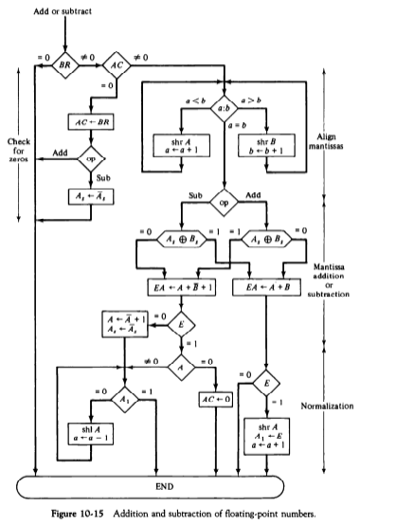
Flow chart

Slide 79
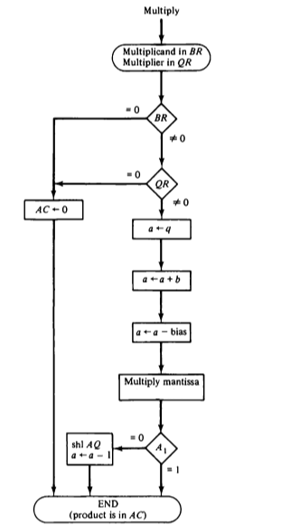
FLOATING POINT MULTIPLICATION
Check for zeros.
Add the exponents.
Multiply the mantissas.
Normalize the product.

Slide 80
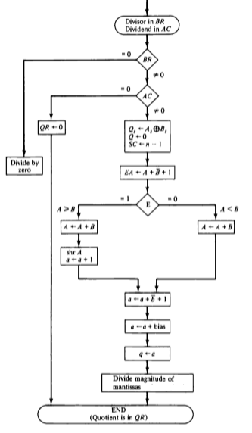
Floating point Division
1. Check for zeros.
2. Initialize registers and
evaluate the sign.
3. Align the dividend.
4. Subtract the exponents.
5. Divide the mantissas.

